Slide 1
Computer Security Principles
COMP6824001
Protecting The Clients
Session 11

Slide 2
These slides have been adapted from:
Panek, Crystal. (2019). Security Fundamental, John Wiley & Sons, Inc. Indianapolis. ISBN: 978-1-119-65066-9
Lesson 5
Acknowledgement

Slide 3
- Types of Malware
- User Account Control (UAC)
- Cloud Computing
- Cloud Security Concepts
- Cloud Security Approaches
- The IoT
- IoT Security
- Protecting Email
- Email Spoofing
- Cookies and Privacy
- Content Zones
- Phising and Pharming
Sub Topics

Slide 4
Type of Malware
Because it is quite common for a computer to be connected to the Internet, there are more opportunities than ever for a computer to be infected by malware.
In addition, over the last couple of years, the number of malware attacks perpetrated over the Internet is staggering.
Malware can be identified as one or more of the following:
  Virus
  Worm
  Trojan horse
  Spyware and dishonest adware
  Rootkit
  Backdoor
  Polymorphic virus
  Zero-day attack
  Ransomware
Notes:
A polymorphic virus mutates, or changes its code, so that it cannot be as easily detected.
Stealth viruses try to hide themselves by monitoring and intercepting a system’s call. For
example, when the system seeks to open an infected file, the stealth virus disinfects the file
and allows the operating system to open it. When the operating system closes the file, the
virus re-infects the file.

Slide 5
Using Common Sense with Malware
To avoid malware, be sure to use common sense by following these suggestions:
Don’t install unknown software or software from an unknown source.
Don’t open strange email attachments.
Don’t click hyperlinks from strangers or if it’s unclear what the link is supposed to do. This also applies to sources like Yahoo!, AOL, and MSN.
If your email client supports auto launch, turn it off. Otherwise, you might automatically activate a computer virus just by opening the email.
Don’t visit questionable websites, especially sites that allow downloading software from music and video piracy sites and porn sites.
If your web browser alerts you that a site is known for hosting malware, pay attention to these warnings.
If you surf the Internet and browser pop-ups indicate that you need to download the newest driver or check your system for viruses, use caution.
Don’t forget to perform regular backups. So, if a computer does get a virus and data is lost, you can restore from a backup.
Notes:
Crystal Panek, page 140-143

Slide 6
User Account Control (UAC)
User Account Control (UAC) is a feature that was introduced in Windows Vista and is included with Windows 10. UAC helps prevent unauthorized changes to your computer, thereby helping to protect your system from malware.
If logged on as an administrator, UAC prompts you for permission; and if logged on as a standard user, UAC will prompt for an administrator password before performing actions that could potentially affect your computer’s operation or other users’ computers.
UAC is designed to make sure that unauthorized changes are not made by potentially malicious software that you may not know is running.

Slide 7
Cloud Computing
Cloud computing:
A model for enabling ubiquitous, convenient, on-demand network access to ashared pool of configurable computing resources (e.g., networks, servers, storage, applications,and services) that can be rapidly provisioned and released with minimal management effort orservice provider interaction.
This cloud model promotes availability and is composed of fiveessential characteristics, three service models, and four deployment models (NIST SP 800-145)

Slide 8
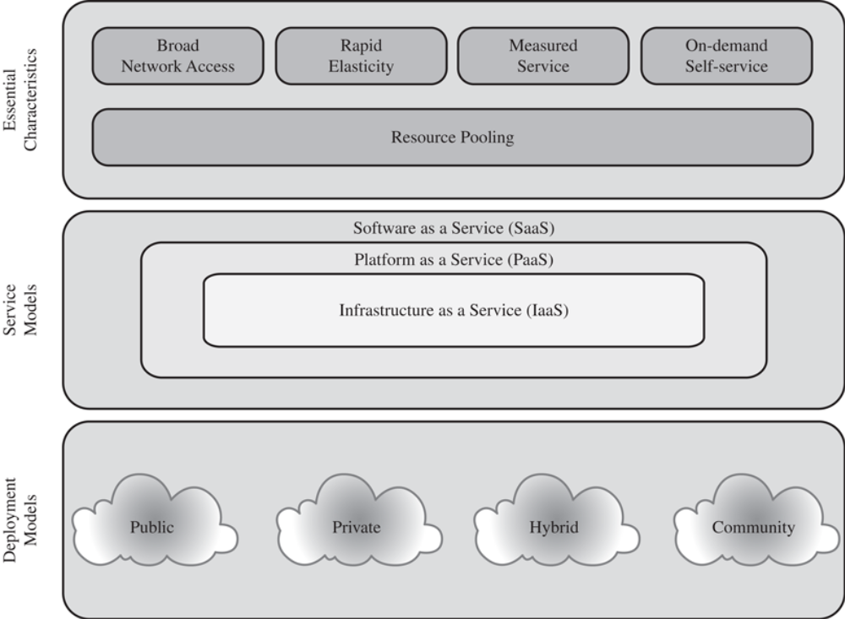
Cloud Computing Elements
Fig 1 Cloud Computing Elements

Slide 9
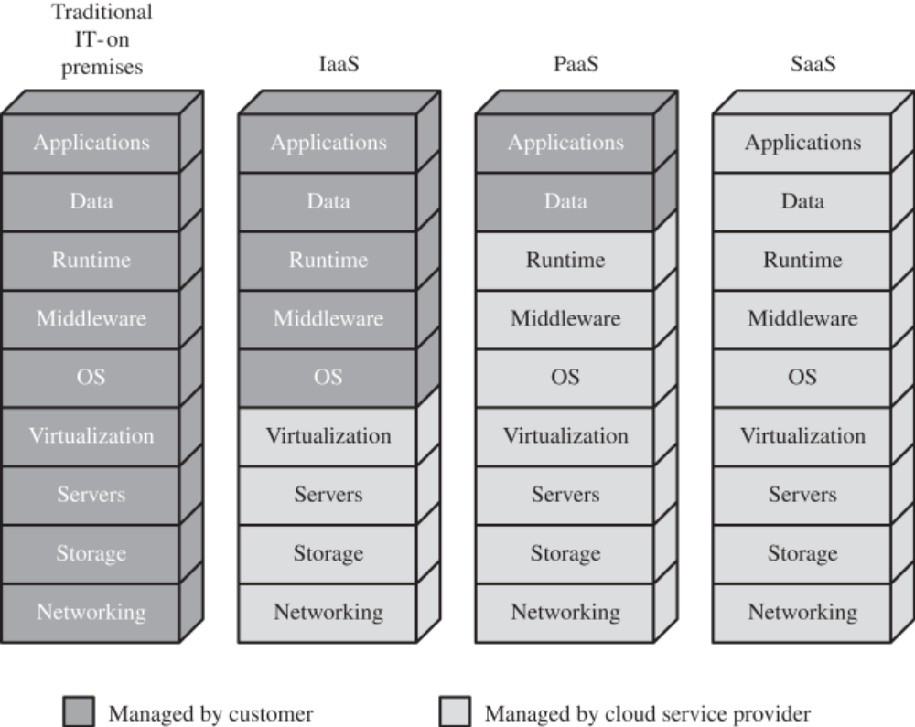
Cloud Computing Services
Fig 2 Cloud Computing Services

Slide 10
CLOUD SECURITY CONCEPTS
There are numerous aspects to cloud security and numerous approaches to providing cloudsecurity measures. A good example of the scope of cloud security concerns and issues is seen inthe NIST guidelines for cloud security, specified in NIST SP 800-144 (Guidelines on Security andPrivacy in Public Cloud Computing, December 2011).

Slide 11
Cloud Security Approaches
The Cloud Security Alliance [CSA13] lists the following as the top cloud-specific security threats:
  Abuse and nefarious use of cloud computing
  Insecure interfaces and APIs
  Malicious insiders
  Shared technology issues
  Data loss or leakage
  Account or service hijacking
  Unknown risk profile

Slide 12
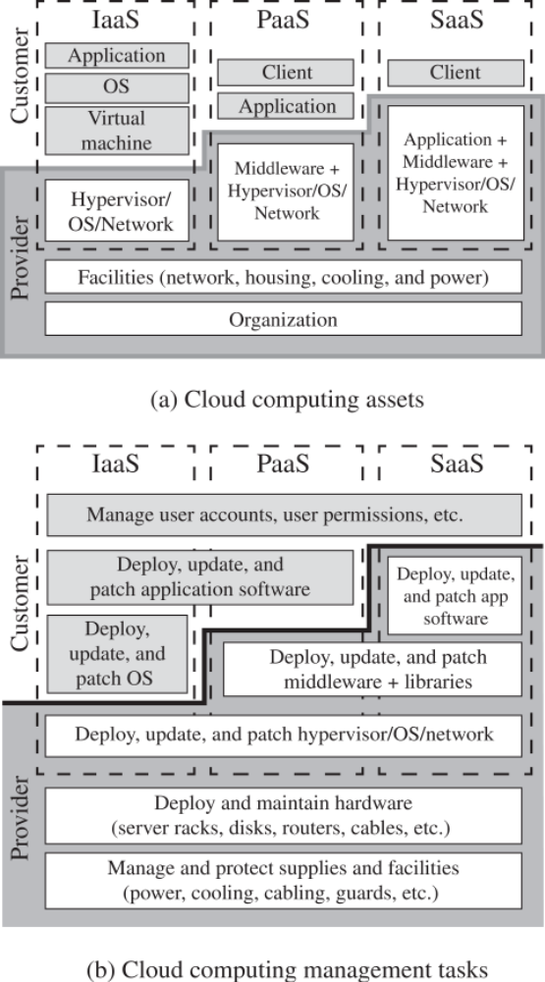
Cloud Security Approaches

Slide 13
Cloud Security Approaches

Slide 14
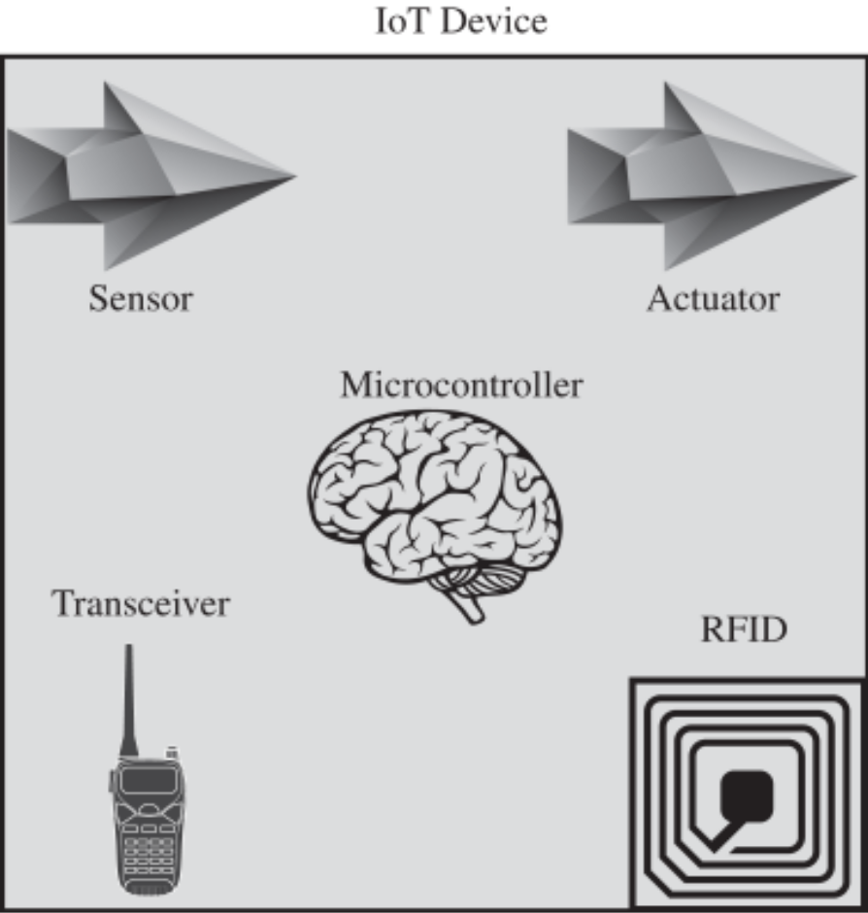
The IoT
Fig IoT Components

Slide 15
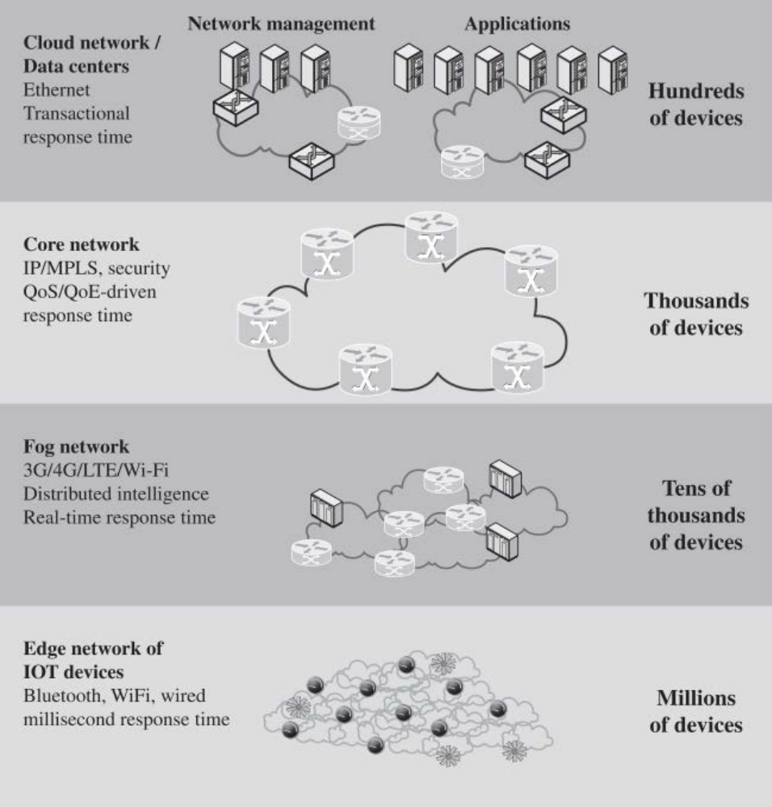
The IoT
Fig IoT and Cloud

Slide 16
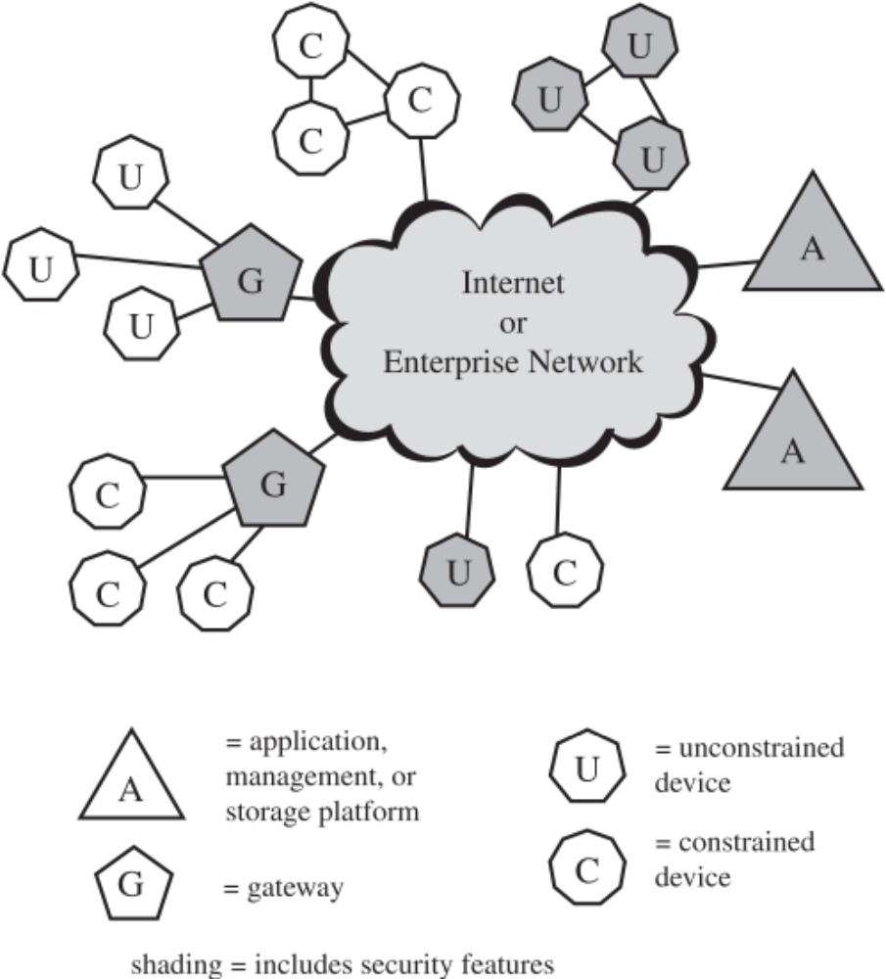
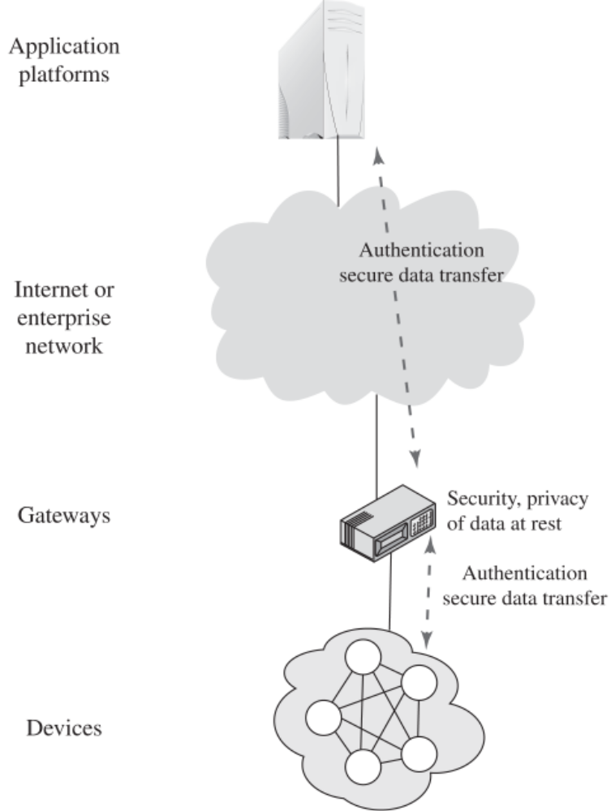
IOT SECURITY
Fig IoT Element of Interest
Fig IoT Gateway Function

Slide 17
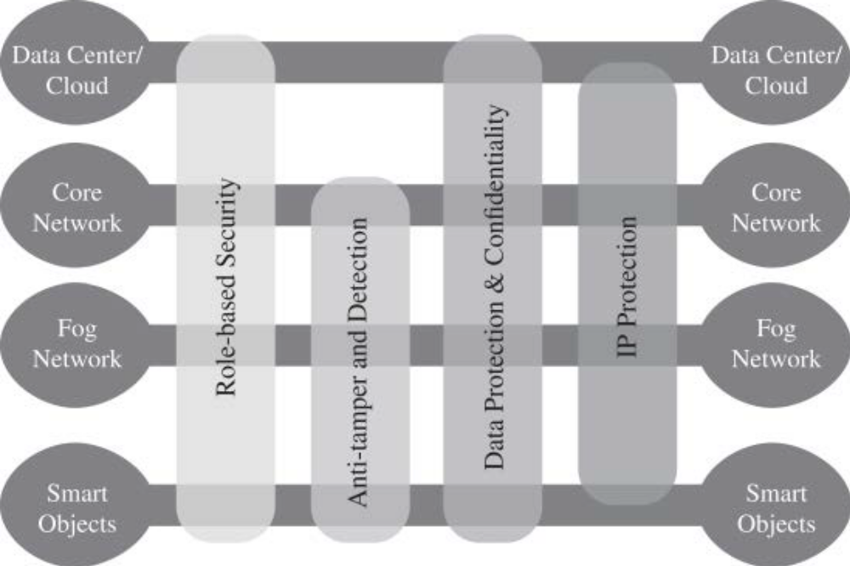
IOT SECURITY FRAMEWORK
Fig IoT Security Framework

Slide 18
Protecting Email
Managing Spam
  Spam filtering systems will not catch every single spam message. Like an antivirus package, the spam filtering solution needs to be kept up-to-date and needs to be constantly tweaked. Antispam solutions will also use Real-time Blackhole Lists (RBLs) or a DNSbased Blackhole List (DNSBL).
Email Spoofing
    Email spoofing is the creation of a false email header where an attacker is tricking the recipient into thinking that the email came from a trusted source. The attacker alters parts of the email of it to look as though it were written by someone else
Relaying Email
  One of the primary email protocols is SMTP. Simple Mail Transfer Protocol (SMTP) is used to transfer email from one server to another, and it is responsible for outgoing mail transport. SMTP uses TCP port 25.

Slide 19
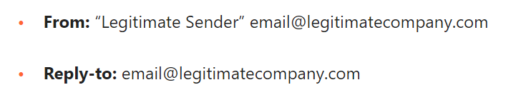
Email Spoofing
Email Spoofing
    Email spoofing is the creation of a false email header where an attacker is tricking the recipient into thinking that the email came from a trusted source.
    The attacker alters parts of the email of it to look as though it were written by someone else
    Here’s an example of what these fields could look like in a spoofed email:
Notes:
https://www.cloudflare.com/learning/email-security/what-is-email-spoofing/

Slide 20
Email Spoofing
Email Spoofing
    Email spoofing is the creation of a false email header where an attacker is tricking the recipient into thinking that the email came from a trusted source.
    The attacker alters parts of the email of it to look as though it were written by someone else
    Here’s an example of what these fields could look like in a spoofed email:
Notes:
https://www.cloudflare.com/learning/email-security/what-is-email-spoofing/

Slide 21
Cookies and Privacy
    When using a browser to access the Internet, much can be revealed about a user’s personality and personal information. Therefore, it is important to take steps to ensure that this information cannot be read or used without your knowledge.
    A cookie is a piece of text stored by a user’s web browser. It can be used for a wide range of items including user identification, authentication, storing site preferences, and shopping cart contents.
    While cookies can give a website a lot of capabilities, they can also be used by spyware programs and websites to track people. Unfortunately, some websites will not operate without cookies.

Slide 22
Content Zones
    Internet Explorer divides your network connection into four content zones or types.
      Internet Zone
      Local Intranet Zone
      Trusted Sites Zone
      Restricted Sites Zone

Slide 23
Phishing and Pharming
    Phishing and pharming are forms of attacks to get users to access a bogus website so the phisher or pharmer can spread malware and/or collect personal information.
    Phishing is a technique based on social engineering. With phishing, users are requested (usually through email or other websites) to supply personal information by:
      Receiving an email that requests your user name, password, and other personal information such as account numbers, PINs, and Social Security numbers.
      Redirecting a user to a convincing-looking website that requires users to supply personal information, such as passwords and account numbers.

Slide 24
References
Panek, Crystal. (2019). Security Fundamental, John Wiley & Sons, Inc. Indianapolis. ISBN: 978-1-119-65066-9
Stallings, William and Lawrie Brown. 2018. Computer Security: Principles and Practice, 4th Edition. Global Edition, Pearson Education Limited
https://www.cloudflare.com/learning/email-security/what-is-email-spoofing/
Notes:
Resources:
https://www.cloudflare.com/learning/ddos/glossary/open-systems-interconnection-model-osi/
https://www.cloudflare.com/learning/ddos/glossary/open-systems-interconnection-model-osi/
https://learningnetwork.cisco.com/s/contentdocument/0693i000001r6HTAAY
https://www.cloudflare.com/learning/network-layer/what-is-ipsec/
https://www.hypr.com/security-encyclopedia/transport-mode#:~:text=Transport%20Mode%20is%20a%20method,Transport%20Mode%20or%20Tunnel%20Mode.
https://www.ibm.com/docs/en/zos/2.2.0?topic=encapsulation-transport-mode-tunnel-mode
https://docs.oracle.com/cd/E36784_01/html/E36838/ipsecov-13.html
https://www.hypr.com/security-encyclopedia/tunnel-mode#:~:text=Tunnel%20Mode%20is%20a%20method,address%20information%20is%20also%20encrypted.

